Slide 1

SMS messenger
The Team:
Lead Software Developer/Team Lead/Ticket Leader:
Michael Madrigal
Software Developers & Design/Requirements:
Kendall Bailey/Emilio J. Mercado
Look & Feel:
Kendall Bailey
Unit Testing:
Emilio J. Mercado
Use Case Testing:
Nesthor Perez & Shrey Mittal

Slide 2
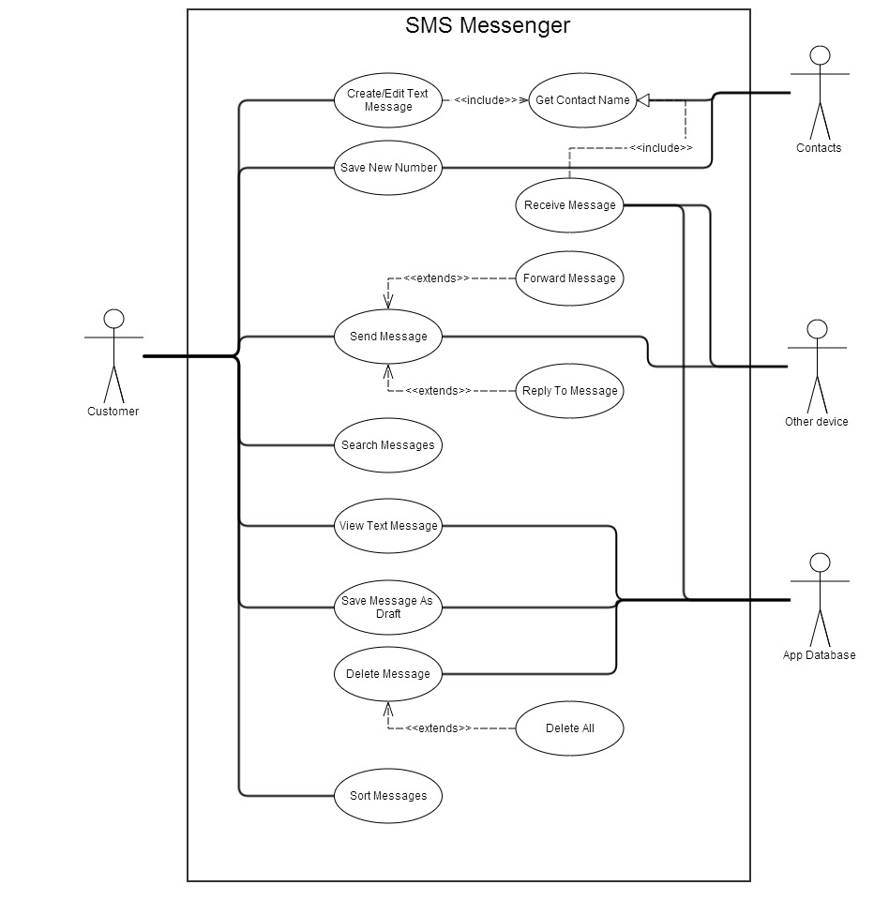
The Design

Slide 3
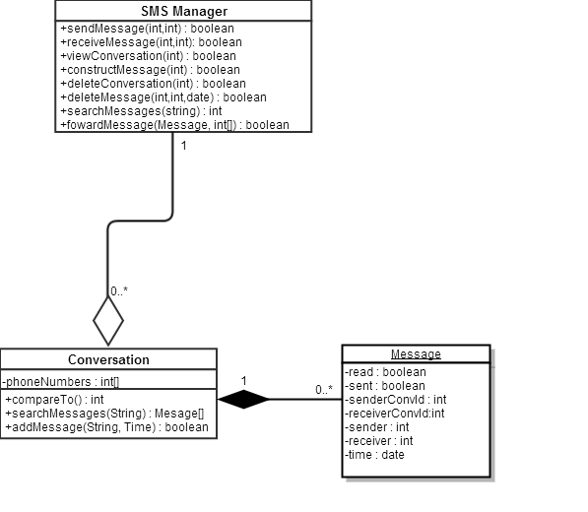
The Design Original Case Diagram

Slide 4
The Features (What can our app do?)
Create, Send and Receive Messages
Auto-create, view and manage conversations
Contact Information tie in to Messages using Phone’s Contacts
Extra Features:
Zoom in and out of Message View and Conversation View
Search Conversations for a message with user specified contact or search string

Slide 5
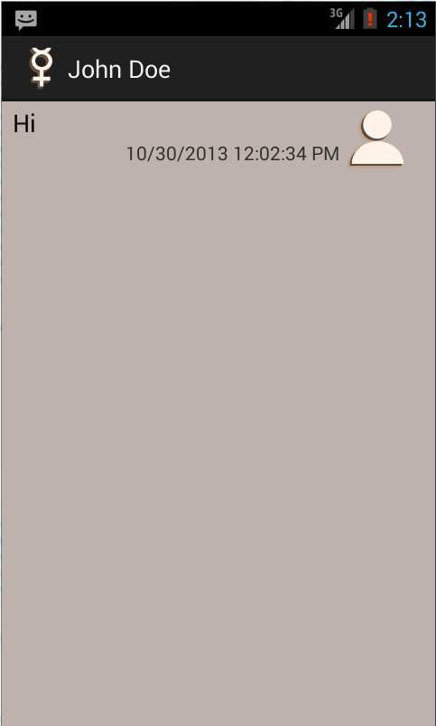
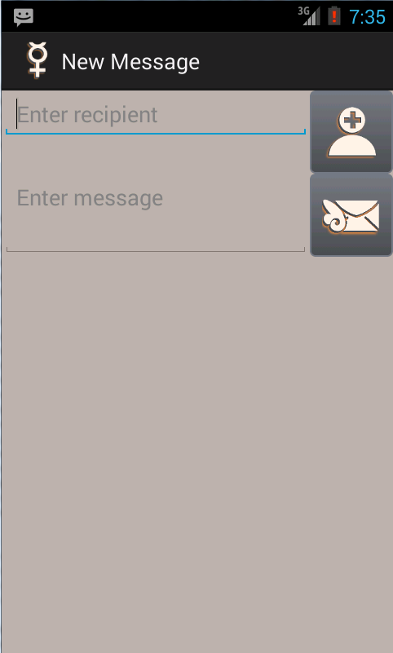
The Features Send And Receive Messages
The Message Location
The Receiver of the Message
Add Contact
Send Message!

Slide 6
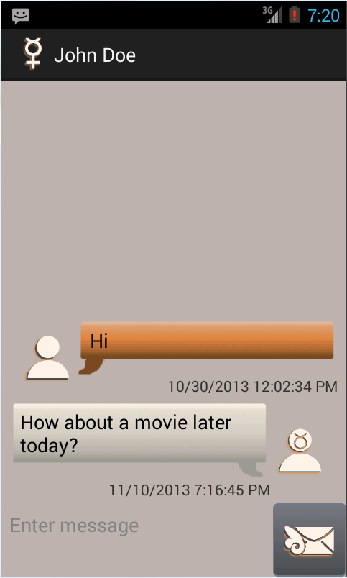
The Features Conversation View

Slide 7
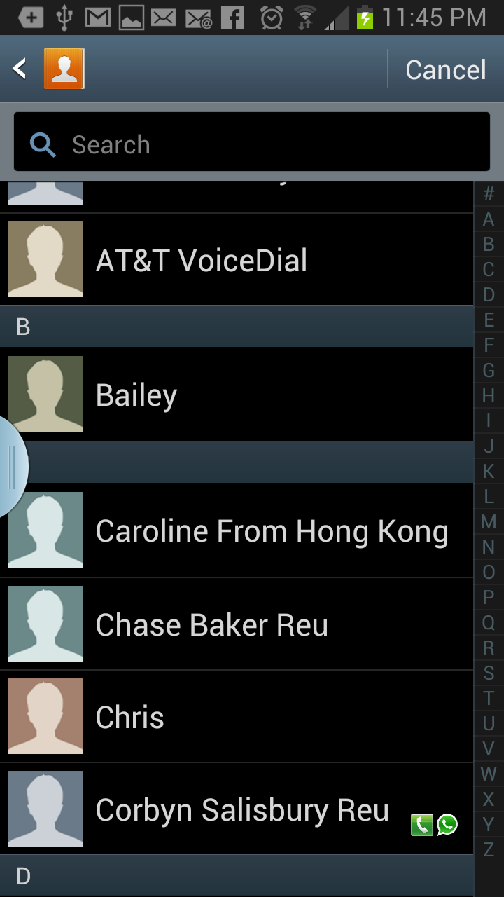

The Features Contact Info Tie In

Slide 8
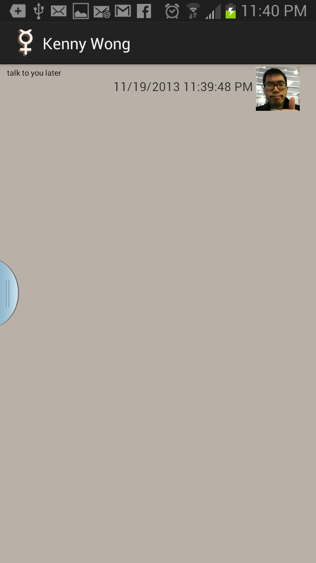
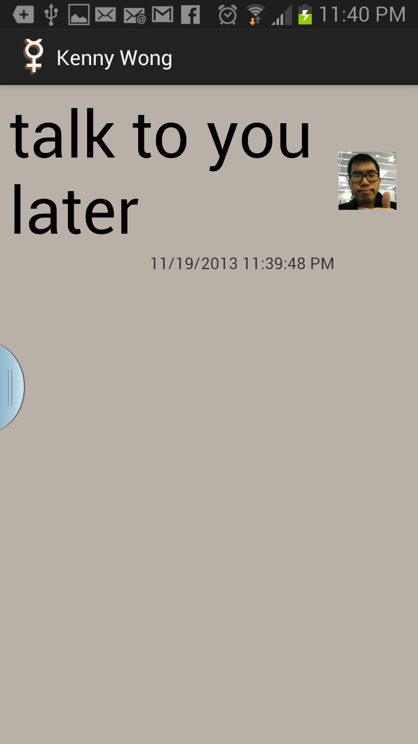
The Features Zoom!

Slide 9
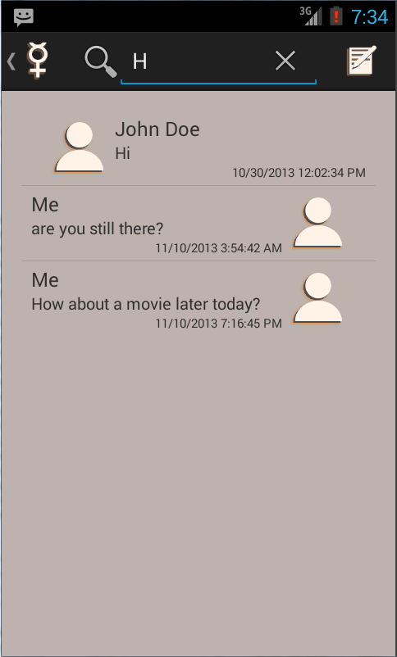
The Features Search Messages!

Slide 10
The Look
LAUNCHER
SEARCH
SETTINGS
NEW MESSAGE
CONTACT
ADD CONTACT
ME
SEND MESSAGE

Slide 11
Challenges along the way
Learning The Android API & Team Work Distribution
Multiple solutions to any given Android Problem. What’s the best way?
Testing the logic
Styling in Android

Slide 12
Challenges along the way Learning The Android API
Android API Learning Curve
Who’s good at what?
The SMS Messenger Framework
Dealing with Android Specific issues
What’s an “Intent Leak”?

Slide 13
What we learned! Learning The Android API
Yay for a framework!
The SMS Framework was built by Michael Madrigral. If it wasn’t for him it would have been a much slower start.
It did add a little learning curve since existing code was already there but nothing intricate enough to cause any issues.
Android Learning Curve?
Slow but once you got the gist it wasn’t difficult to integrate new UI and logic.
The API documentation and online examples are everywhere (but the API documentation was the best reference.

Slide 14
What we learned! The Android API
Dealing with Android Specific issues
Working with BroadcastReceivers
Incoming, sent, and delivered SMS messages.
Dealing with registering and unregistering intent receivers.
Leaked intent receiver exception.
Working with cursors.
Close after using.
Working with ListViews and ArrayAdapters.

Slide 15
Challenges along the way Multiple solutions to an android problem
Coding by example
Too many examples online!
What’s correct, what’s optimal?

Slide 16
What we learned! Multiple solutions to an android problem
Best examples are in the API itself
ex: http://developer.android.com/reference/android/provider/ContactsContract.PhoneLookup.html
Take your time understanding what does what and how it does it.
Don’t settle for the first example you find online!

Slide 17
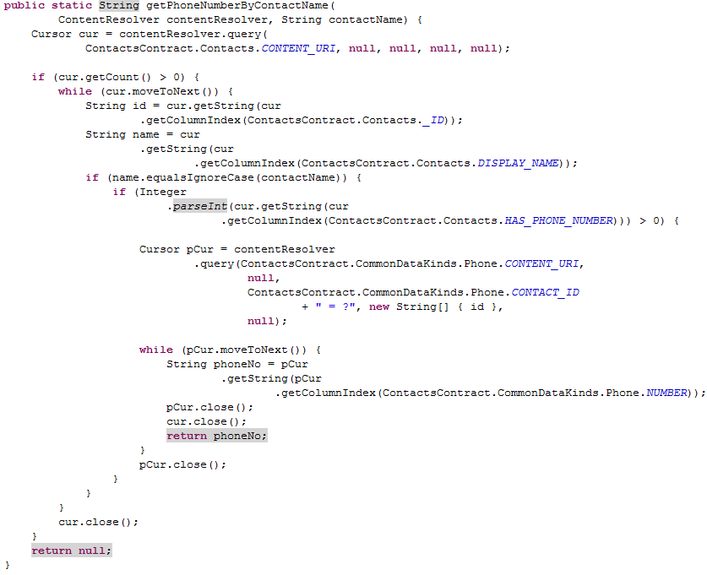
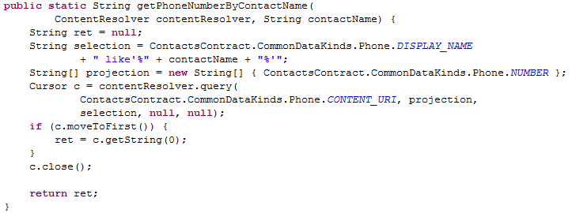
What we learned! Multiple solutions to an android problem
Slow Approach
The Fast Approach

Slide 18
Challenges along the way Unit Testing
Who knows how to unit test!?
What is junit?
What do we unit test?
The logic only?
The features?

Slide 19
What we learned! Unit Testing
The intuition of what to test relies on knowing what the logic does!
The Android Junit Testing Capability
http://developer.android.com/tools/testing/index.html
http://robolectric.org/
Testing the concrete logic
Learned the power of changing code and quickly testing the logic to make sure it still functions!

Slide 20
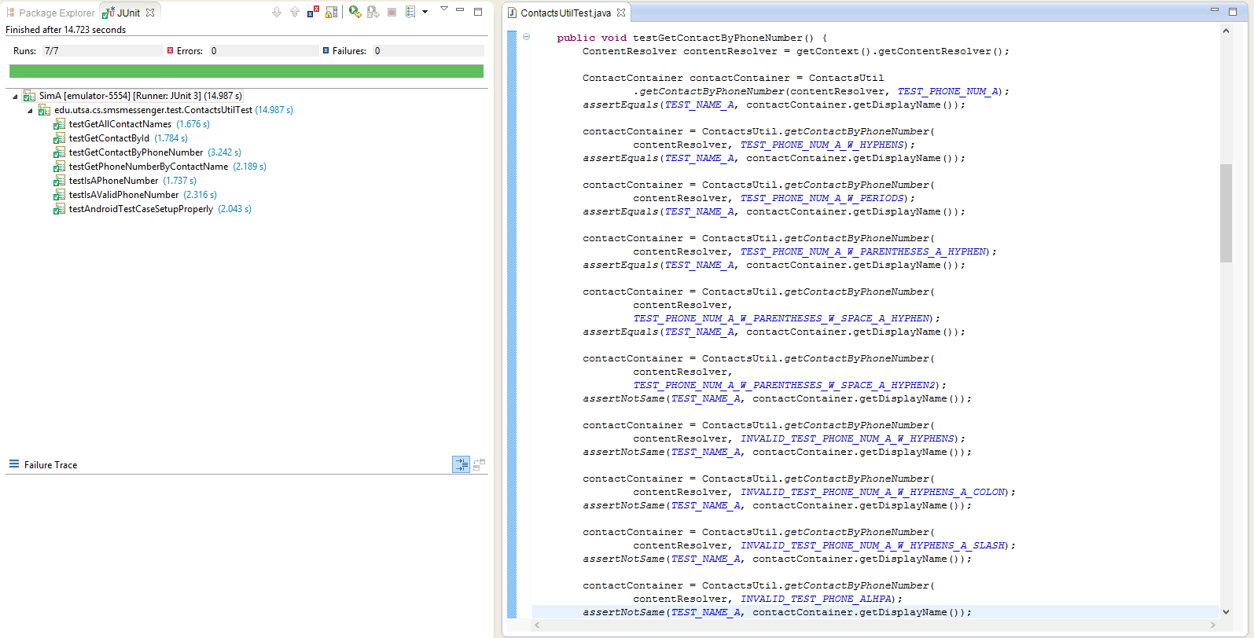
What we learned! Unit Testing(JUnit example)

Slide 21
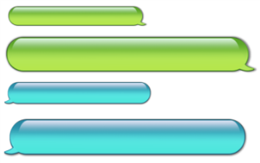
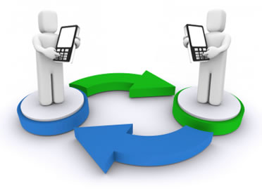



Challenges along the way Test Cases
Sender
phone #
Receiver
phone #
Text message
Message
ID message
Time stamp

Slide 22
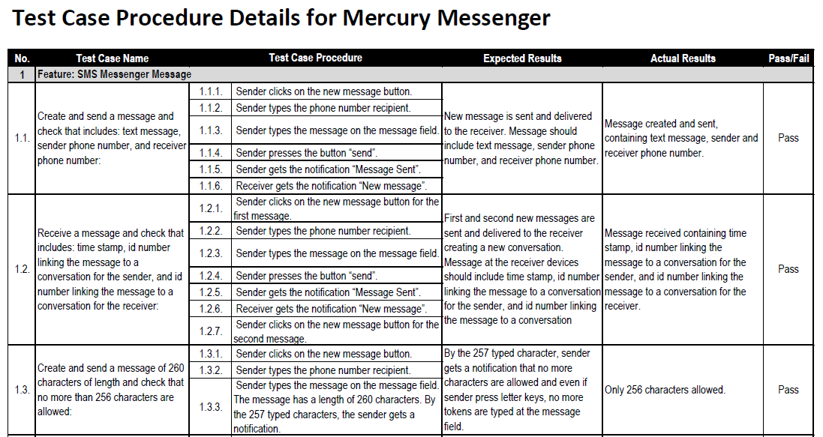
What we learned! Test Cases

Slide 23
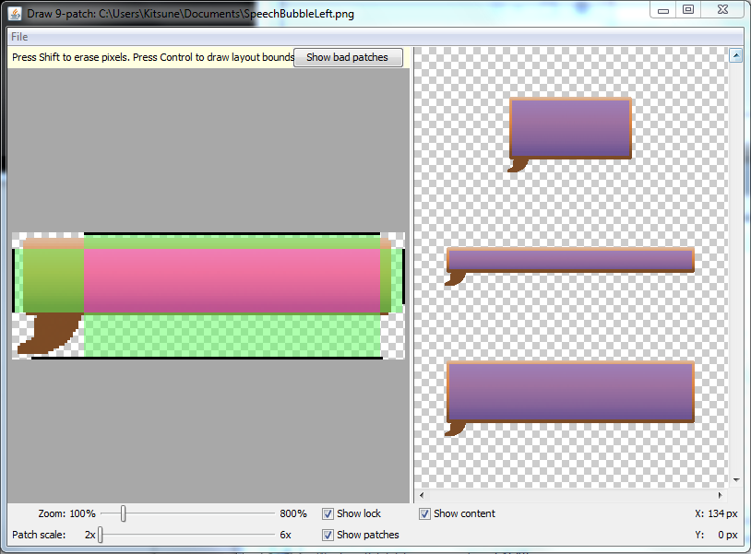
What we learned! Styling in Android

Slide 24
Future Work
Allow sending messages to multiple users.
Create conversation room.
Don’t wait for a message sent confirmation before updating Activity.
Haptic feed back and GUI animation for button presses.

Slide 25
Demo time!

